Slide 1
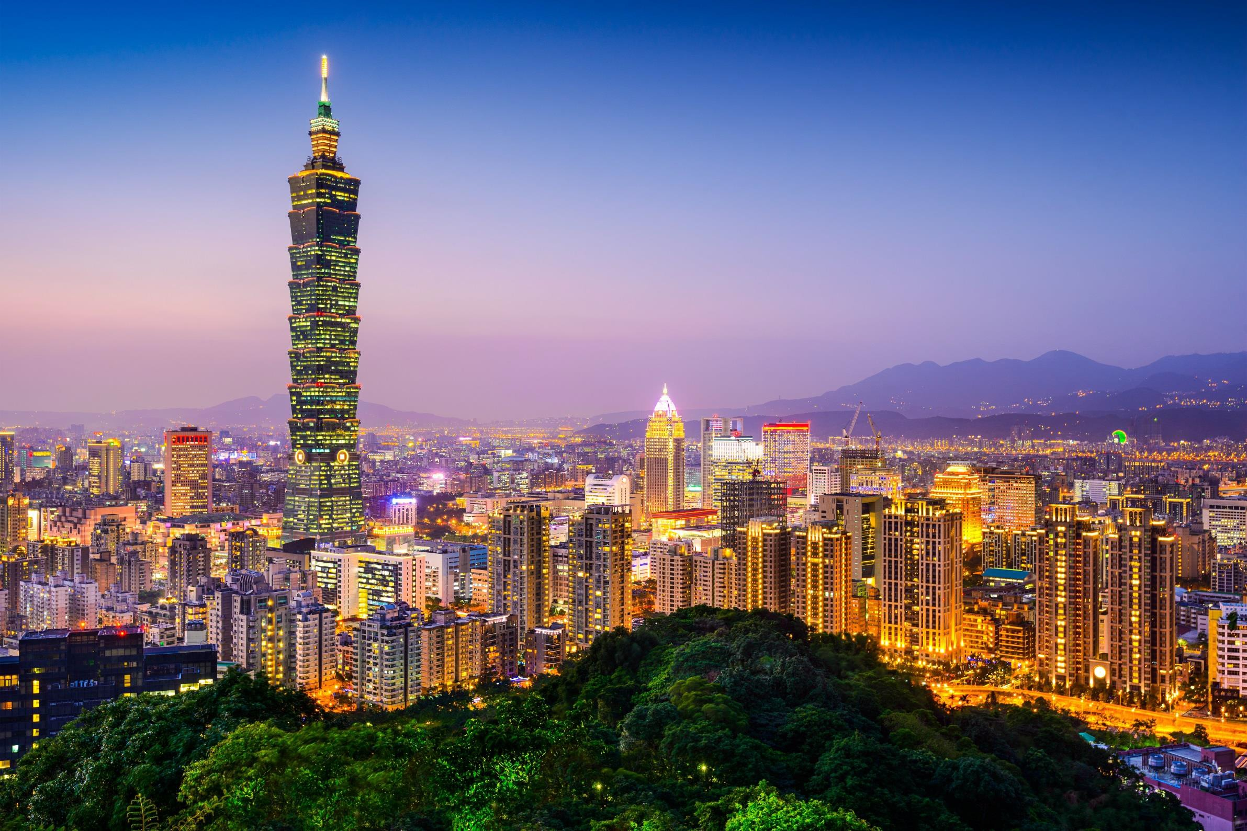



Discover Asia Pacific’s business opportunities through CACCI
- Taiwan Perspective
KPMG Deal Advisory 18 September 2017

Slide 2


Contents
1
KPMG’s Successful Platform within ASEAN
2
Taiwan's Historical Investments in ASEAN
3
Success Stories
4
Taiwan’s Investment Potential in ASEAN

Slide 3
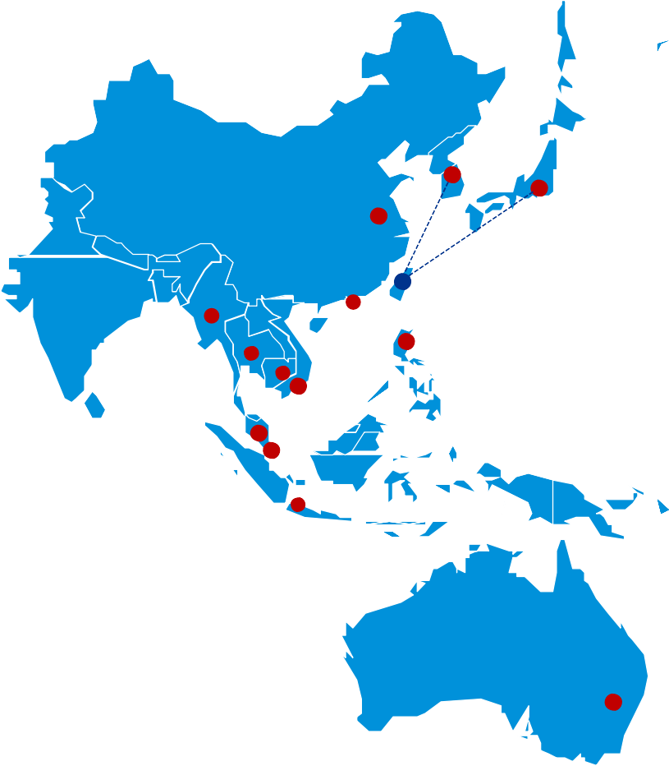








KPMG’s Successful Platform within ASEAN
Discover Asia Pacific’s business opportunities through CACCI – Taiwan Perspective
I.
Establish the one and only
professional service platform
China
/Shanghai
II.
Carry out OneKPMG Strategy
India
Myanmar
Thailand
Vietnam
Philippine
ASPAC Taiwan
Practice Platform
III.
Assist Taiwanese enterprises
to enter into ASPAC Market
IV.
Assist Asia-Pacific enterprises
to enter into Taiwan Market
Indonesia
V. Establish a fresh working model for all-around services
: Close working relationships
: Taiwan desks

Slide 4




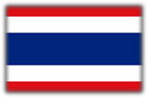


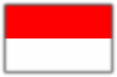
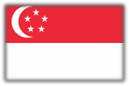
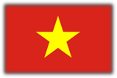


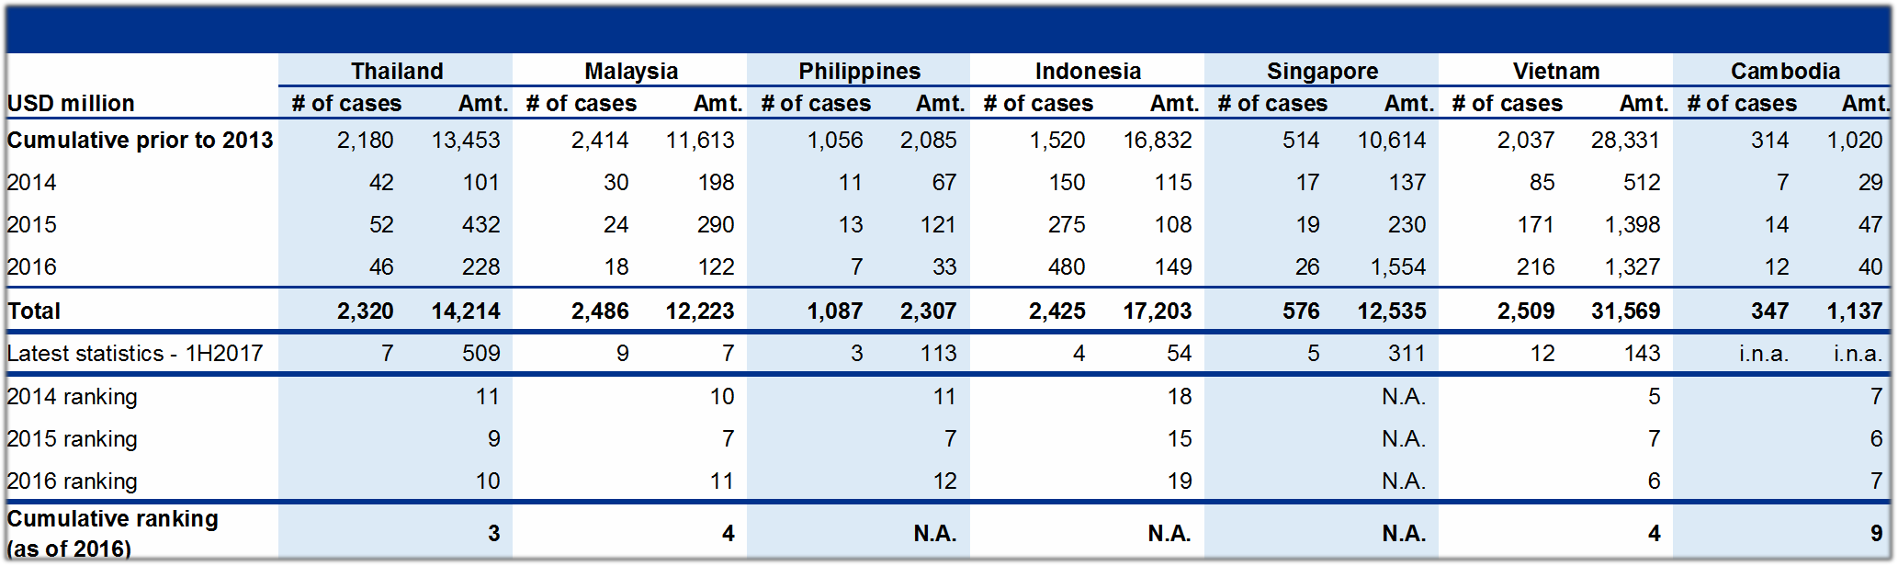

Taiwan’s Historical Investments in ASEAN
Discover Asia Pacific’s business opportunities through CACCI – Taiwan Perspective
Note: The select ASEAN countries presented above include only those where Taiwan has significant investments in that date longer than 10 years.

Slide 5








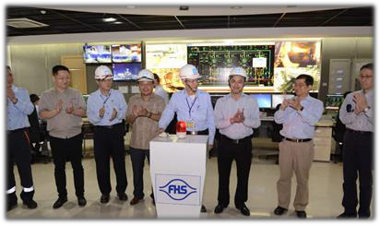



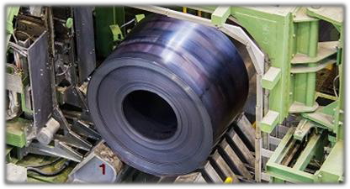

Success Stories
Discover Asia Pacific’s business opportunities through CACCI – Taiwan Perspective
Vietnam
Story 1 – Formosa Ha Tinh Steel Corporation (“FHS”)
FHS received its investment certificate on 12 June 2008. The port and plant where FMS operates in is currently the biggest foreign direct investment (FDI) project in Vietnam.
1.
2.
Up to 100,000 of employees required from related enterprises for the factory’s operation.
Transportation, economic and power infrastructures were created in Vietnam as a result of this project. The project will contribute to make Vung Ang economic zone become the biggest heavy industrial center in SouthEast Asia.
3.
Manufacturing milestones:
(1) 25 December 2015 – The first hot rolled coil made in Vietnam was produced by the Hot Strip Mill Plant.
4. (2) 30 March 2016 – The first wire rod coil was produced by the Wire Rod and Bar Plant.
(3) 2 June, 2017 – The first slab made in Vietnam was
produced by the Continuous Casting Plant.
© 2017 KPMG Deal Advisory Limited, a Taiwan company limited by shares and a member firm of the KPMG network of independent member firms affiliated with KPMG International Cooperative ("KPMG International"), a Swiss entity. All rights reserved. Printed in Taiwan.
5
Source: Public information and the official website of Formosa Plastics Group.

Slide 6
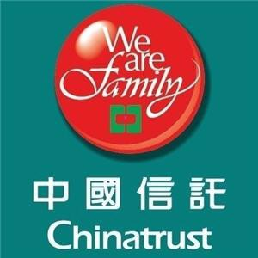






Success Stories
Discover Asia Pacific’s business opportunities through CACCI – Taiwan Perspective
Thailand
Story 2 – Chinatrust Commercial Bank (“CTBC”) acquires 35.6% of LH Financial Group (“LHFG”)
1.
CTBC is the first Taiwan-funded commercial bank entering into Thailand market since 1947.
2.
On 27 July 2017, CTBC successfully acquired 35.6% shares of LHFG.
35.6%
100%
Being optimistic about the prospect of Thailand’s economy and having advantage of owning Tokyo Star Bank (“TSB”), CTBC is confident in assisting LHFG to secure Taiwanese and Japanese clients in Thailand.
3.
5,000+
Taiwanese companies based at Thailand
Benefit from China’s “Belt and Road” initiative - expects capital requirements to fund the infrastructures planned for Thailand. With CTBC’s funding support, LHFG is capable of fulfilling the cash demands within the market and expected to further-extend its asset portfolio.
4.
10,000+
Japanese companies based at Thailand
Source: Public information and the official website of CTBC and LHFG.

Slide 7






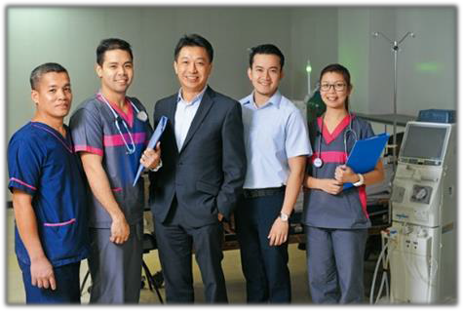

Success Stories
Discover Asia Pacific’s business opportunities through CACCI – Taiwan Perspective
Philippines
Story 3 – Excelsior Healthcare Group (“Excelsior”) invested dialysis market within Philippines
With more than 20 years of experience and expertise in dialysis services and long-term care, Excelsior successfully set up a 100%-owned Philippines subsidiary – EG Healthcare in 2003.
1.
Partner
EG Healthcare’s major operating businesses:
Medical services provider – generates 30% of revenue
Medical products provider – generates 70% of revenue
Hospitals
2.
Through years of efforts, EG Healthcare owns 5 dialysis centers, ranks top 3 for its dialysis services and has around 11% market share in the Philippines.
3.
Source: Public information, The official website of Excelsior Healthcare Group

Slide 8




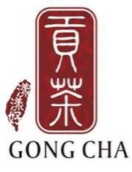
Success Stories
Discover Asia Pacific’s business opportunities through CACCI – Taiwan Perspective
ASEAN and Globally
Story 4 – Taiwanese-brand restaurants/cafes invest in ASEAN market
Thailand | 3 restaurants
Malaysia | 8 restaurants
Singapore | 20 restaurants
Indonesia | 13 restaurants
Philippines | 2 restaurants
Others | 80 restaurants
Thailand | 2 stores
Malaysia | 156 stores
Philippines | 47 stores
Indonesia | 142 stores
Singapore | 2 stores
Vietnam | 11 stores
Cambodia | 16 stores
Myanmar | 15 stores
Others | 270 stores
: Din Tai Feng (鼎泰豐)
: Gong Cha (貢茶)
: Chatime (日出茶太)
Vietnam | 20 stores
Philippines | 7 stores
Others | 1000+ stores
Source: The official website of Din Tai Feng, Gong Cha, and Chatime.

Slide 9





Success Stories
Discover Asia Pacific’s business opportunities through CACCI – Taiwan Perspective
ASEAN
Story 5 – Taiwanese textile companies invest in ASEAN market
4 July 4, 2017 – Lealea Group acquired 70% shares of Indonesia Taroko Textile.
Indonesia | 2m yard/month | Nylon and Polyester Woven fabrics | 700 employees
Vietnam | 1.4m kg/month | Knitted fabric | 600+ employees
 | 2.4m pcs/month | Garments | 11,000+ employees
Cambodia | 0.5m pcs/month | Garments | 1200+ employees
Vietnam | 4.1m pcs/month | Garments
Indonesia | 3.8m pcs/month | Garments
Cambodia | 2.7m pcs/month | Garments
Philippines | 0.7m pcs/month | Garments
Indonesia | 0.9m pcs/month | Garments | 5,600+ employees
Cambodia | 1.5m pcs/month | Garments | 3,800+ employees
: Lealea Group
: ECLAT Textile
: MAKALOT
: Tainan Enterprises
: Roo Hsin
Source: Public information, The official website of Lealea Group, ECLAT Textile, MAKALOT, Tainan Enterprises and Roo Hsin.
Cambodia | 1.1m pcs/month | Garments | 3,500+ employees

Slide 10


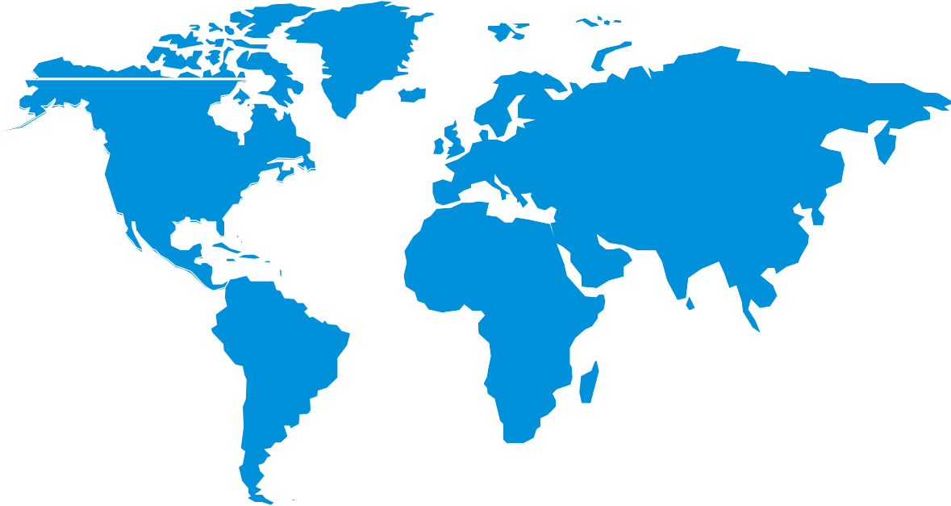
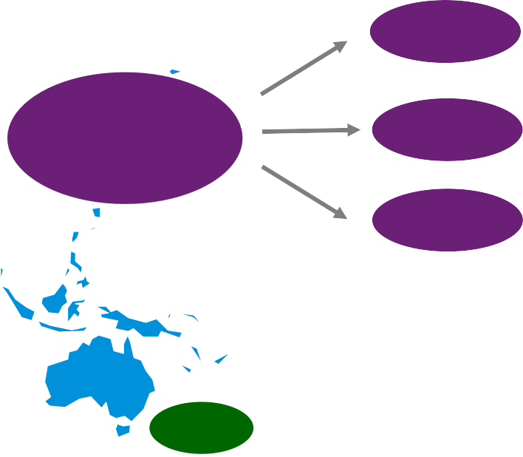



Taiwan’s Investment Potential in ASEAN
Discover Asia Pacific’s business opportunities through CACCI – Taiwan Perspective
Taiwan investments in the global market
58%
China
5%
Europe
74%
11%
ASEAN
19%
Americas
Asia
5%
Others
Africa
0.3%
Cumulative investments from Taiwan to ASEAN have been significant, accounting for approximately 11% of Taiwan’s total investments in the global market.
Oceania
1%
Taiwan's import and export with ASEAN
Import Export |  |  |  |  | Total trade amt.
USD million | Amt. | share(%) | Amt. | share(%)
2012 | 31,854 | 11.50% | 57,088 | 18.60% | 88,942
2013 | 33,059 | 11.90% | 59,220 | 19.00% | 92,279
2014 | 34,725 | 12.30% | 60,172 | 18.80% | 94,897
2015 | 29,039 | 12.20% | 51,639 | 18.10% | 80,678
2016 | 27,155 | 11.80% | 51,291 | 18.30% | 78,446
1H2017 | 15,430 | 12.40% | 27,789 | 18.80% | 43,219
Imports and exports from/to ASEAN account for a significant share of Taiwan’s overall international trade each year.
Source : Department of Statistics, Ministry of Finance (ROC), "Summary of Exports and Imports for June 2017".

Slide 11
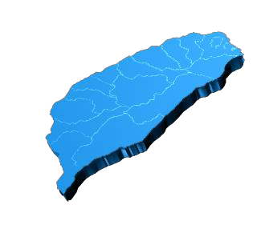
Taiwan’s Investment Potential in ASEAN
Discover Asia Pacific’s business opportunities through CACCI – Taiwan Perspective
The New Southbound Policy
Taiwan is an important member of the ASPAC region. The New Southbound Policy is a response towards the change in global conditions and regional integration, and is critical to our economic and trade strategy.
The Policy identifies a new direction and driving force. It redefines our important role in Asia's development, and to create values for the future.
Through this policy, the Taiwanese government hopes to engage in wide-ranging dialogue and negotiation with the ASEAN and South Asian nations as well as New Zealand and Australia, with the goal to establish close cooperation to allow us to achieve, collectively in partnership, regional development and prosperity.
Plans:
Promote economic collaboration
Share resources
Forge regional links
Conduct talent exchange

Slide 12
© 2017 KPMG Deal Advisory Limited, a Taiwan company limited by shares and a member firm of the KPMG network of independent
member firms affiliated with KPMG International Cooperative ("KPMG International"), a Swiss entity. All rights reserved. Printed in Taiwan. ¹²
Contact
Vincent Chang
Deal Advisory
Partner, KPMG Taiwan
Tel:+886281016666
vwchang@kpmg.com.tw

Slide 13
© 2017 KPMG Deal Advisory Limited, a Taiwan company limited by shares and a member firm of the KPMG network of independent member firms affiliated with KPMG International Cooperative ("KPMG International"), a Swiss entity. All rights reserved. Printed in Taiwan.
The information contained herein is of a general nature and is not intended to address the circumstances of any particular individual or entity. Although we endeavor to provide accurate and timely information, there can be no guarantee that such information is accurate as of the date it is received or that it will continue to be accurate in the future. No one should act on such information without appropriate professional advice after a thorough examination of the particular situation.
The KPMG name and logo are registered trademarks or trademarks of KPMG International.

