Slide 1

2017 APEC Overview

Slide 2
APEC 2017 Business Sector Priorities
PRIORITIES:
Preventing protectionism and supporting trade and investment liberalization
Promoting connectivity
Inclusive and sustainable growth
Developing robust financial markets
Notes:
Good afternoon Ladies and Gentlemen,
It’s my great pleasure to be here to share with you about priorities for the APEC business sector in 2017 and plans for the APEC CEO SUMMIT 2017.
Building on the work of the past host economies, Viet Nam has identified the following priorities for private sector this year
Preventing protectionism and supporting trade and investment liberalization
Promoting connectivity
Inclusive and sustainable growth
Developing robust financial markets

Slide 3
APEC 2017 Business Sector Priorities
Preventing protectionism and supporting trade and investment liberalization
  Achieve the Bogor Goals
  Promote the development of a FTAAP
  Promote trade in services
Promoting connectivity
  Institutional connectivity
  People to people connectivity
  Physical connectivity
Notes:
On Preventing protectionism and supporting trade and investment liberalization, the focus will be on accelerating work on trade and investment liberalization to achieve the Bogor Goals, strengthening connectivity, developing value chains and connecting supply chains and advancing services and investment cooperation.
We will also provide input on APEC’s connectivity agenda. This includes building out the physical infrastructure that the Asia-Pacific needs, improving business and labor mobility and promoting institutional connectivity such as regulatory cooperation between APEC members.

Slide 4
APEC 2017 Business Sector Priorities continued
Inclusive and sustainable growth
Inclusive growth
  Creating a favorable business environment that stimulates innovation, fosters entrepreneurship and promotes good corporate governance
  Facilitating MSME access to international markets and global value chain
  Promoting human development in the digital era
  Strengthening the participation of women in the economy
Sustainable growth
  Promoting APEC partnership in climate-smart food security
  Sustainable management of natural resources
  Developing sustainable rural areas
  Achieving energy security and sustainability
  Promoting a healthy and productive workforce
Notes:
Inclusive and sustainable growth shall be having two aspects:
Increasing access to economic opportunity. We want to sure that all parts of societies have the opportunity to benefit from open markets and economic liberalization. We intend to have a particular focus on micro, small and medium sized enterprises and women’s economic engagement.
Under the priority of Sustainable Growth, we will focus on climate-smart food agriculture, Sustainable management of natural resources, developing sustainable rural areas, achieving energy security and sustainability and promoting a healthy and productive workforce.

Slide 5
APEC 2017 Business Sector Priorities continued
Developing robust financial markets
  Promoting the development and integration of capital markets and strengthening financial market infrastructure
  Facilitating MSME access to international markets and global value chain
  Stimulating public and private investment for infrastructure and shaping pension and insurance development
  Enhancing MSME access to finance
Notes:
Finally, our last priority will be engaging with APEC’s Finance Minister to promote the development of robust financial markets with a focus on the issues noted here.

Slide 6

CEO Summit Theme and Key Topics
CEO Summit Theme: Creating New Dynamism, Fostering a Shared Future
Key Topics
  The Future of Globalization and APEC Integration
  4th Industrial Revolution and the World Economy
  Developing a 21st Century Workforce
  MSMEs in Global Markets and Digital Age
  New Frontier for Trade, Global value chain, Sharing Economy
  Eco-friendly, Smart Agriculture and rural development
  Resource Efficiency and sustainability
Notes:
In the spirit of public-private sector cooperation, we have adopted the theme for the APEC CEO Summit that is the same as the government’s APEC 2017 theme. That is: Creating New Dynamism , Fostering a Shared Future.
The key topics for discussion will be : the future of globalization and APEC integration, the fourth industrial revolution and the world economy, developing a 21st Century Workforce, MSMEs in Global Markets and digital age, New frontier for trade, global value chain, The sharing economy, Eco-friendly, smart agriculture, rural development, resource efficiency and sustainability.

Slide 7
APEC PROSPERITY
Six golden letters
I&S: Inclusive and Sustainable
M&W: MSMEs and Women
I&L: Innovation and Liberalisation

Slide 8
Vietnam Business Summit
Theme : Vietnam : We mean Business
Key topics:
Vietnam – turning point of reform
Vietnam – the next emerging market
Vietnam – integration and business opportunities
Sub-topics for breakout sessions: - Smart agriculture; - Infrastructure development; - Finance services; - Tourism & special economic zones; - Education and health care; - MSMEs, Start-up and renovation
Notes:
The them for Vietnam Business Summit will be: “Vietnam: We mean business”. Key topics to be presented will include: Vietnam – the turning point of reform, Vietnam – the next emerging market, and Vietnam – integration and business opportunities.
Su-topics of breakout sessions will be: - Smart agriculture; - Infrastructure development; - Finance services; - Tourism & special economic zones; - Education and health care; - MSMEs, Start-up and renovation.
Vietnamese Prime Minister, ministers will address the Summit. Foreign investors and delegates will have chances to meet and interact with Ministers and Chairmen/Mayors of 63 provinces of Vietnam as well as the prominent companies from all the provinces.

Slide 9
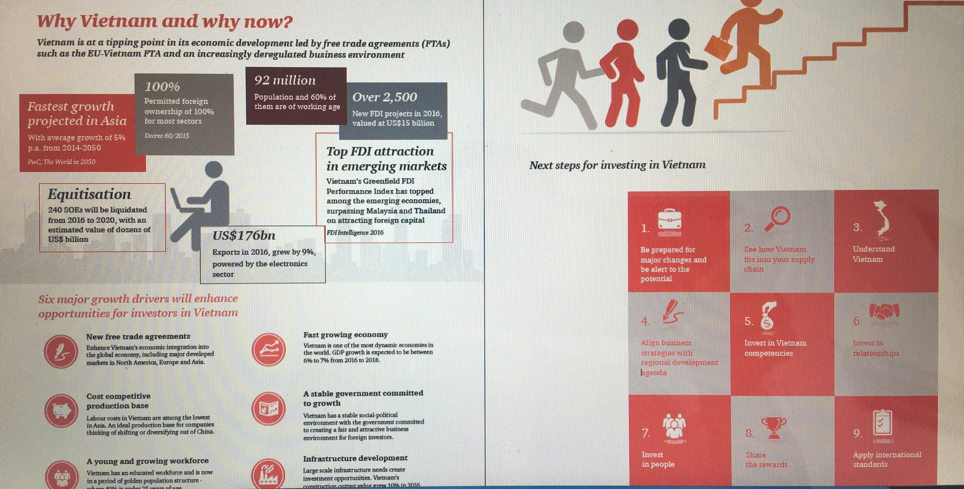
Vietnam Business Summit
Why Vietnam and why now?
Notes:
The them for Vietnam Business Summit will be: “Vietnam: We mean business”. Key topics to be presented will include: Vietnam – the turning point of reform, Vietnam – the next emerging market, and Vietnam – integration and business opportunities.
Su-topics of breakout sessions will be: - Smart agriculture; - Infrastructure development; - Finance services; - Tourism & special economic zones; - Education and health care; - MSMEs, Start-up and renovation.
Vietnamese Prime Minister, ministers will address the Summit. Foreign investors and delegates will have chances to meet and interact with Ministers and Chairmen/Mayors of 63 provinces of Vietnam as well as the prominent companies from all the provinces.

Slide 10
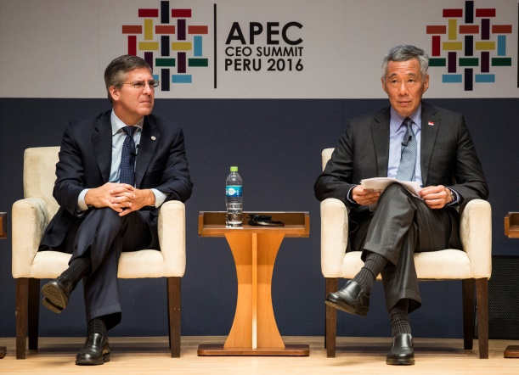
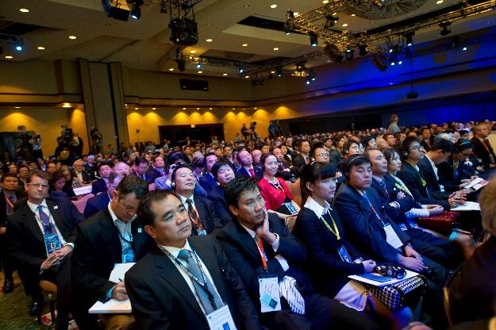
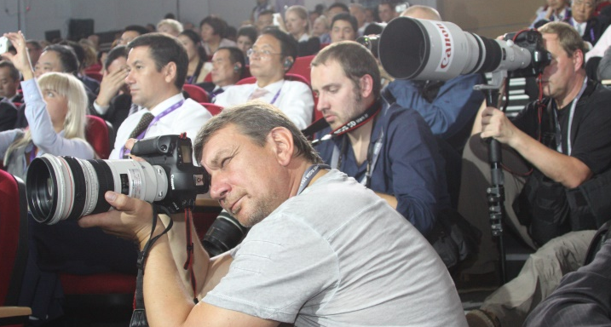
Participants
Program Participants
  APEC Leaders
  Global CEOs
  Thought Leaders
Delegates
  1,000 business leaders from the APEC Region and beyond
International Media
  Over 500 global media outlets
Notes:
We expect to have about 10-12 APEC Leaders speak at the Summit.
Global CEOs and thought leaders are invited to dialogue with 1000 business delegates from APEC region and beyond.
The CEO Summit is considered to be the ‘Board Meeting’ of the Asia Pacific and will provide ample opportunities for networking.

Slide 11
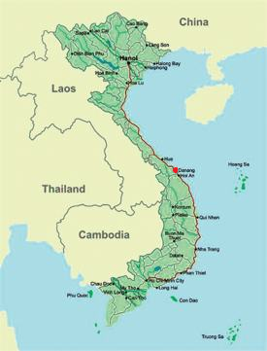
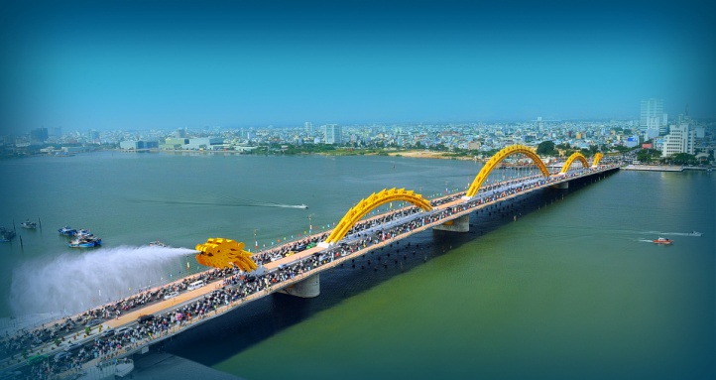
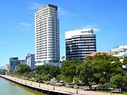
Location
Da Nang – “The City of Events”
Population: 1.05 million (2015)
GDP growth: 9.8% in 2015
Key industries: seafood, textiles, footwear, engineering, building materials etc.
International flights: Bangkok, Beijing, Guangzhou, Hong Kong, KL, Seoul, Singapore, Tokyo and others
Notes:
The City of Event is Da Nang -The most livable city in Vietnam with beautiful beaches, and very close to many world heritages, such as the ancient capital Hue, merchant township Hoi An, My Son relics, etc.
Da Nang is connected to the world with international flights from Bangkok, Beijing, Guangzhou, Hong Kong, KL, Seoul, Singapore, Tokyo and others.

Slide 12
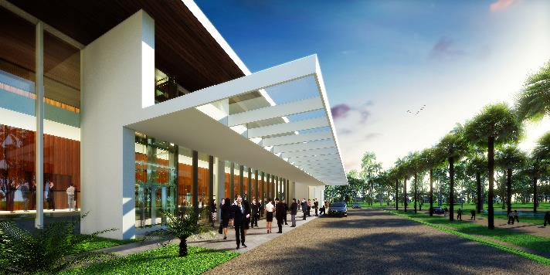
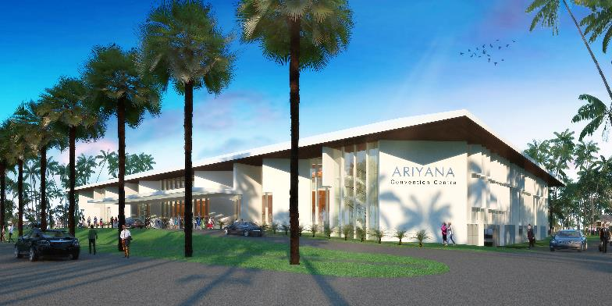

Venue
Danang - Ariyana Exhibition & Convention Centre
  Total area of 4,390m²
  Grand Ballroom with capacity for 2,500
Notes:
The venue for the Summit is Danang-Ariyana Exhibition Convention Center (ADECC)- a newly built complex for this special occasion with the total area of nearly 4500m2

Slide 13
Dates
Business Meetings
ABAC IV | November 4 – 6
Vietnam business Summit | November 7
APEC CEO Summit | November 8 -10
ABAC Dialogue with Leaders | November 10
Government Meetings
Concluding SOM | November 5 - 6
APEC Ministerial Meeting | November 8 - 9
APEC Leaders’ Meeting | November 10 - 11
Notes:
Danang is also the host for the APEC Leaders’ week with a wide range of important Government and Business meetings.
For Business Meeting we will have the ABAC IV from 4-6, the Vietnam Business Summit on the 7, the APEC CEO Summit from 8-10; the ABAC Dialogue with Leaders on the 10th .
For Government Meeting , the Concluding SOM will be from 5-6; Mininsterial Meeting from 8-9 and the APEC Leader’s Meeting on 10-11.

Slide 14
For more information
Trần Thiện Cường
Executive Director
2017 APEC CEO Summit
www.apecceosummit2017.com.vn
Email: contact@apecceosummit2017.com.vn
Notes:
The above is the brief introduction about APEC 2017 and the APEC CEO Summit. I hope to welcome you all in Danang this November.
Should you need any further information , please contact our ED Mr. Tran Thien Cuong by the above email and website.
Thank you very much for your kind attention.

