Slide 1



CACCI 2017 Sydney
IRAN
Opportunities Unveiled
Pedram Soltani
First Vice President
Iran Chamber of Commerce, Industries, Mines & Agriculture (ICCIMA)
Notes:
Drag and drop the image in the placeholder
Send to back the image (Right click/Arrange/Send to back )

Slide 2
5 Areas of Concentration
Geopolitical &
Geo-economic
Advantages
Market Size
& Access
Human Capital
Natural Resources
Geographic
& Historical Aspects
2

Slide 3
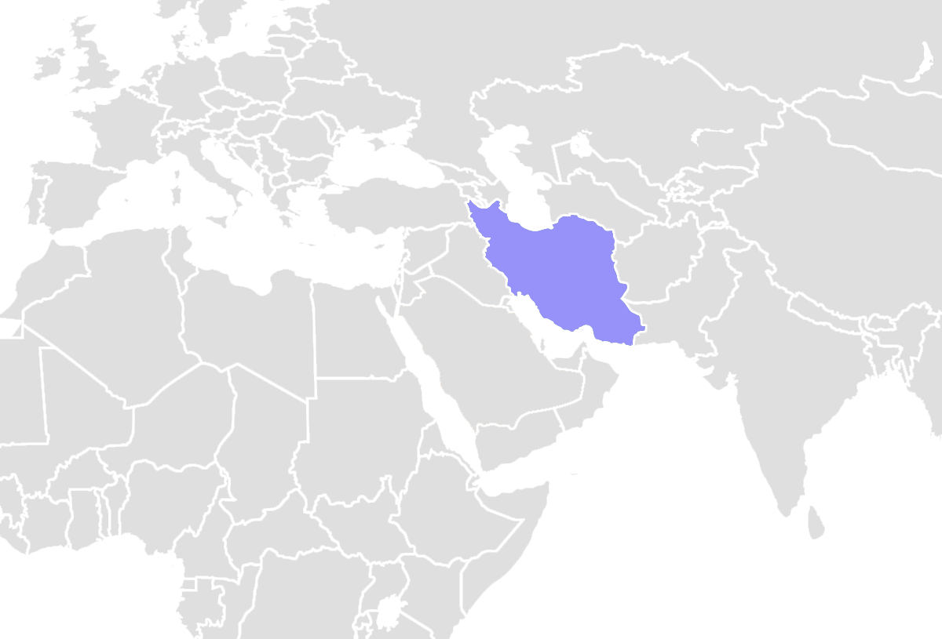
Geopolitical and Geo-economics

Slide 4
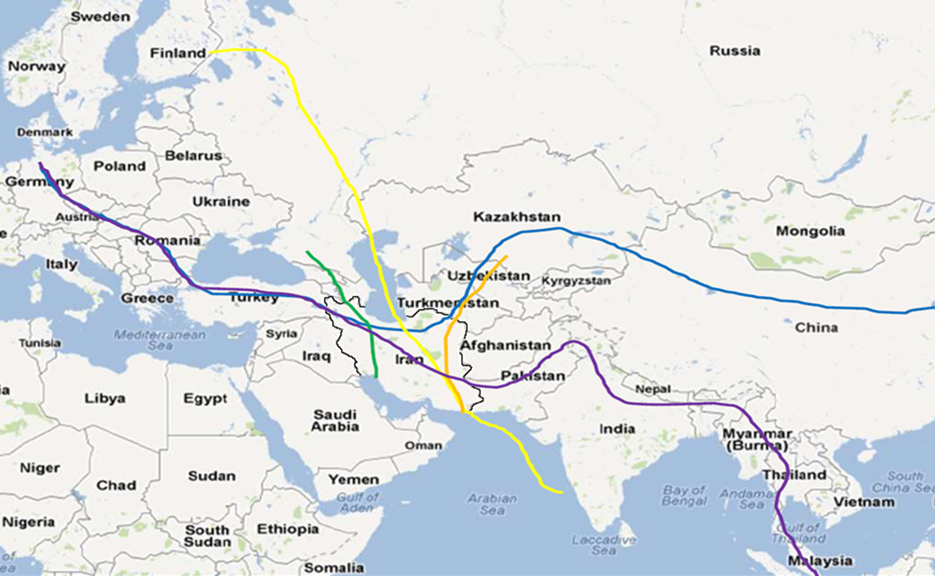
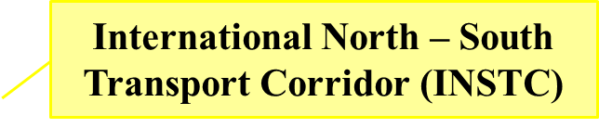
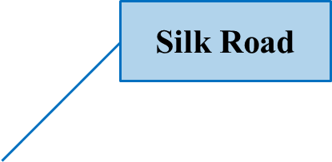


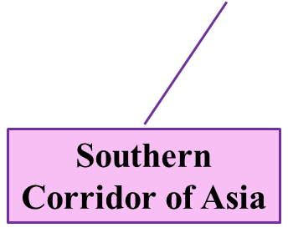
Transport Corridors

Slide 5
Iran's Transit Potentials
Suitable geographical location for import & export in terms of access to production & consumption markets
Large size of the country
Air corridors crossing Iran as the shortest intercontinental air corridor
Long history of trade & business in Iran
Naturally good position of ports in terms of depth & condition of navigation
A potential logistic link between Asia & Europe
Easy access to many countries of the region
Great access to open seas
Long history of trade & business in Iran
Located on international transit corridors
5
Notes:
Source: Mohammadinasab (2010)

Slide 6

Air/Rail/Road Transportation
Ports
Geopolitical + GeoEconomic Opportunities
  Fleet
  Equipment
  Services
  Software & Services
Equipment
  Logistics/Warehousing
Infrastructure

Slide 7

Market Size and Access
Mobile Penetration Rate 94%
Internet Users 57 Million
MENA Connectivity 1st
Key Indicators | Rank
Market size | 19
Domestic market size index | 32
GDP 2016 (Nominal: $393.5 Billion) | 27
GDP 2016 (PPP: $1,352,814 Million) | 18
Neighbors 15 Nations (8 Sea Borders)
Borders 650 Million Population
8% of Global Population
12% of Global Economy
2nd Largest Economy in MENA Region

Slide 8
Market Size and Access: Opportunities
White Goods
Automotive
FMCG
Electronics
Consumers Services
Pharmaceuticals

Slide 9
Tertiary Education Enrollment Rank in the World: 33rd
Youth Population 15-24 Years Old: 29.2%
Human Capital
Engineer Per Capita: 1st in the World
Global Entrepreneurship Monitor
High Status Of Successful Entrepreneurs Rank: 5/60
Internet Market Dynamics Rank: 13/62
Strongest Area: Startup Skills
  Rank: 23
  Similar to China and Australia
Physicians Density (per 1000 Population): 1.491
Concept & Idea

Slide 10
Human Capital: Opportunities
Venture Capital (Start-ups Knowledge-based Firms)
Manufacturing (Engineers, Technicians)
IT Services
(IT Engineers Programmers)

Slide 11
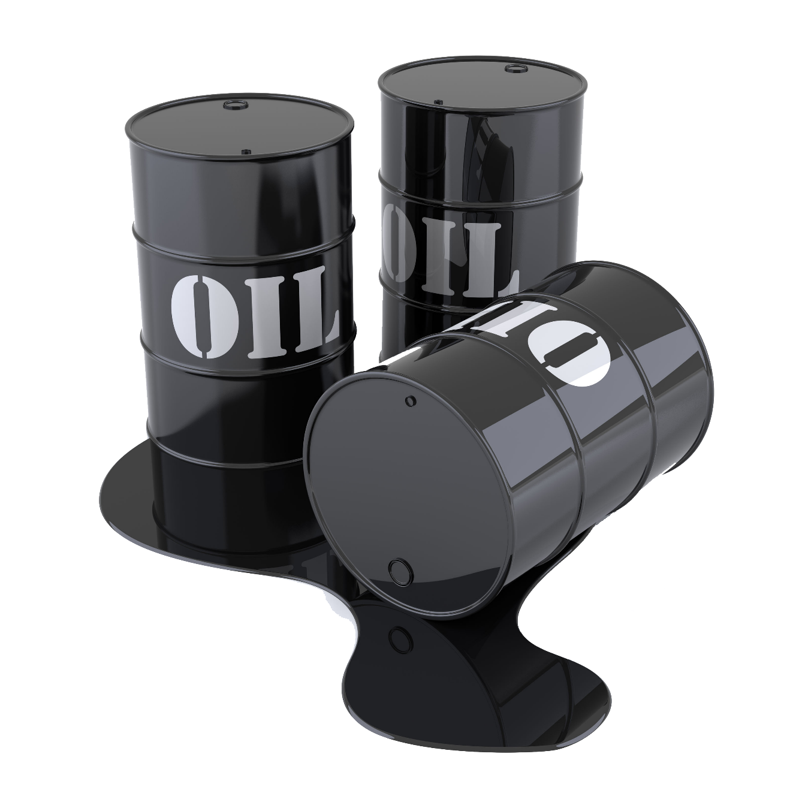
Natural Resources: Oil & Gas
Gas Reserves (to Production Ratio) | 1st (147 years)
Gas Production/Consumption in billion cubic feet | 193/191
Oil Reserves (to Production Ratio) | 4th (128 years)
Oil Production/Consumption in million barrels a day | 4/3
58
46.4
18.8
1.4
  Production Capacity Million Tons
  Actual Production Million Tons
  Total Exports Million Tons
  Total Imports Million Tons
Notes:
Iran’s combined oil and gas production places her at the world’s No.4 Spot. The nature of the reserves makes extraction less onerous and drives down production costs to some of the lowest globally (e.g. less than half of those of Russia’s)

Slide 12

Natural Resources: Minerals
Mineral Reserves in billion tons | 31 ($30 trillion)
1.3% of Global Landmass, Containing 8% of Global Minerals
  68 Types of Minerals & Metals
  Higher Revenue Potential than Energy
  1.3% of World Landmass 8% of its Minerals
  1st in Zinc
  2nd in Copper
  2nd in Gypsum
  4th in Cement

Slide 13
Oil & Gas Fields Services and Equipment
Mining Equipment, Services, Technologies
Natural Resources
Energy Intensive Industries
Downstream Industries (Petrochemicals, Chemicals, Fine Minerals)

Slide 14
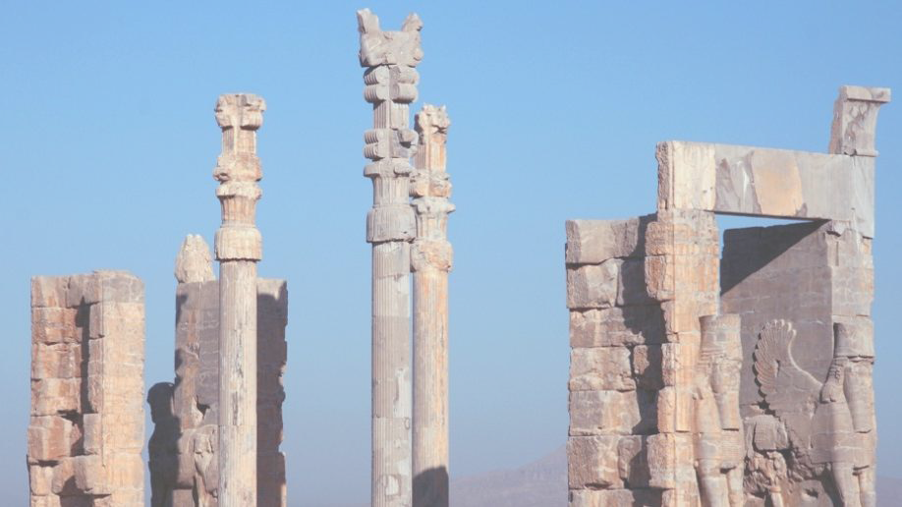
Geographical and Historic Aspects

Slide 15
Tourism: World Rankings
Price Competitiveness 1st in the World
 | Ranks
Eco Tourism | 7
Number of World Heritage Sites | 9
Oral and Intangible Cultural Heritage | 12
Tourist Attractions | 48
UNESCO World Heritage (21 Sites)
Attendance at Museums + Historical Monuments
    15 Million Average Annual

Slide 16
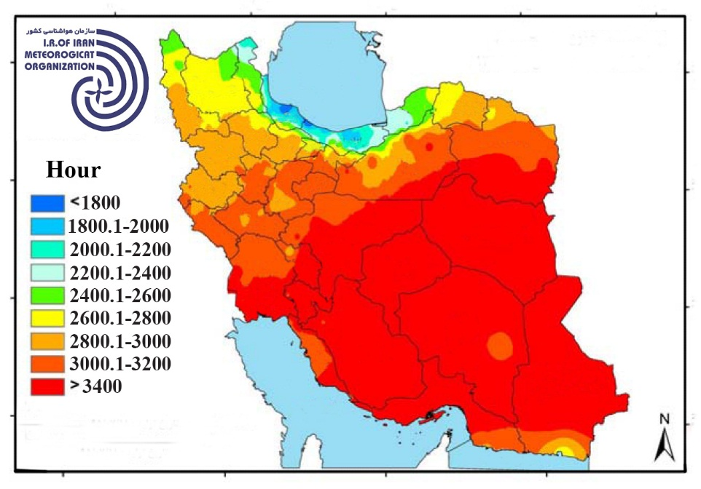
Renewable Energy: Solar Energy
  2800-3200 hours of Annual Sunshine
  4.5 to 5.5 average irradiation kilowatt hours per square meter per day
  300 sunny days in a year in more than two-thirds of the country
  In an Area of 2000 Sq. Km. = 60,000 Watts of Electric Production

Slide 17
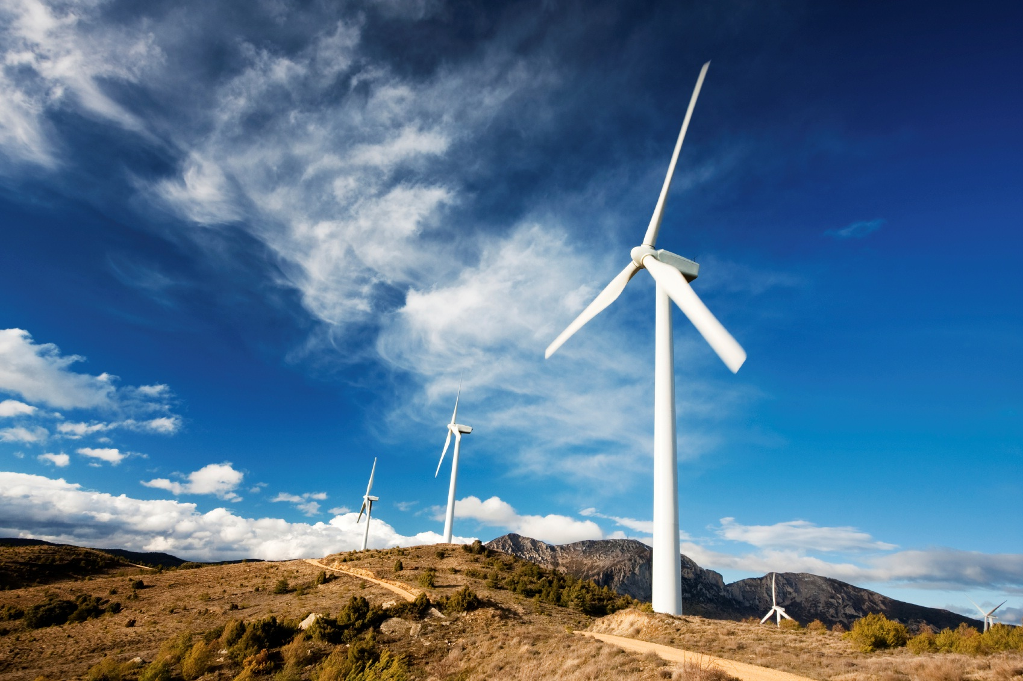
Renewable Energy: Wind Energy
Advantages of Wind Power
    Iran's Potential for Wind Power Generation is 20.000 MW
Iran is Located on Seasonal Wind Belts
    At Least 45 Wind Farms
All Wind Farms in Iran are Capable of Handling 3MW Turbines

Slide 18
Agro-Food Industries: Horticultural Crops
Iran’s World Rankings (2013)
Climate variation for planting various agricultural and horticultural products
The climate of Iran is one of great extremes due to its geographic location and varied topography. The temperature could vary from 55 °C in the Summer to Negative 30 °C in Winter
Unique taste and quality in horticultural produces
1st
Caviar- Barberry- Berries- Pistachio- Saffron
2nd
Walnut – Pomegranate – Apricot - Date
3rd
Cucumber – Melon – Eggplant – Cherry – Water melon
4th and 5th
Pumpkin – Cucurbit – Wool – Silk – Fig – Almond – Quince - Onion

Slide 19
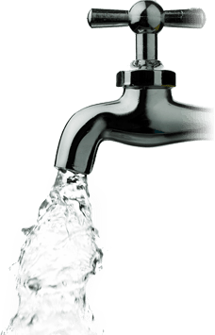
Environment, Water & Agriculture
Water Management - Waste Management
Precipitation 1/3 of Global Average: 242mm vs. 800mm
  70% Evaporation Rate: Higher than any Region except Africa or Australia
Iran’s Greatest Challenge: Water Resources Crisis
  Outlook: Further Decrease in Rainfalls + Rise in regional temperature
  Urgent need to decrease water consumption of the nation
Market for
      Sea and Brackish water desalination
      Waste water treatment
      Green solutions

Slide 20





Geographical and Historic Aspects
Tourism Infrastructure (Parks, Hotels, Transportation)
Agro-Food Industries
Geographical and Historic Characteristics
Opportunities
Tourism (Cultural, Eco, Religious…)
Water Management, Waste Management
Renewable Energy (Solar, Wind, Geothermal)

Slide 21
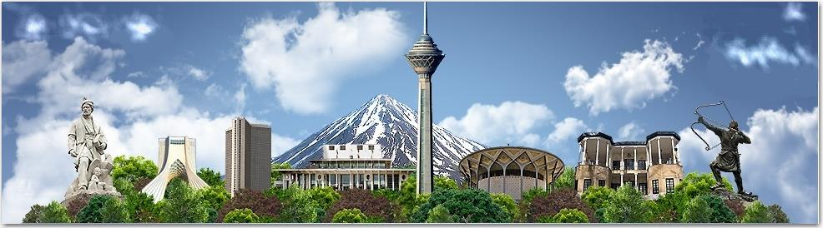
End

